Slide 1
Seat Installer
May 2013

Slide 2
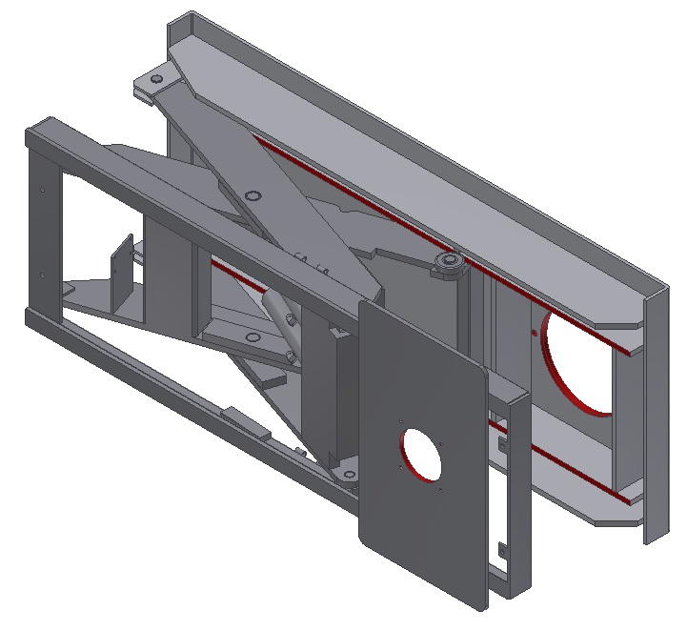
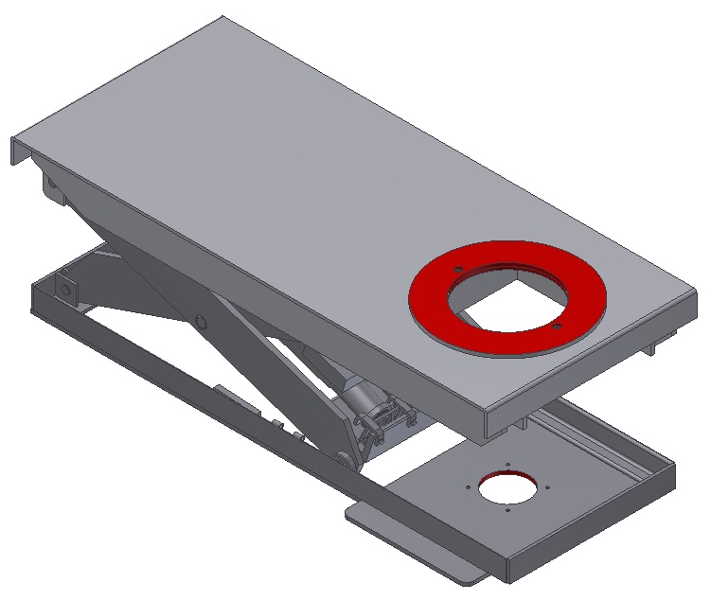
Machined Surfaces
Datum C machined concentric
to datum A and parallel to datum B
Datum B machined at precise offset from rear pivot to ensure parallelism with bottom plate
Locating Datum A
Cold-rolled plate

Slide 3
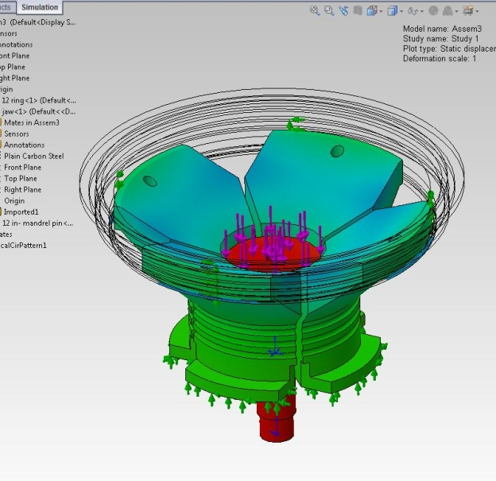
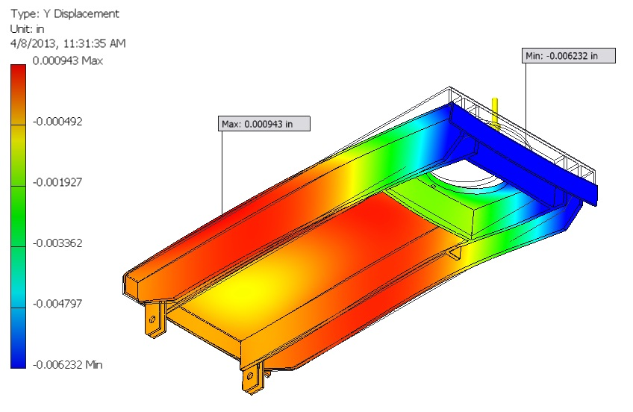
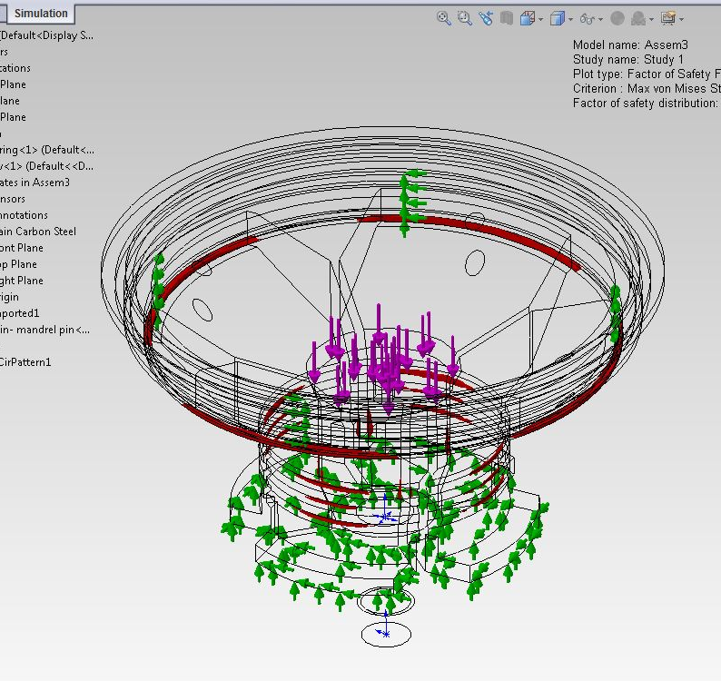
FEA Analysis
12” 150# Seat
Deflection
Max. = .006” @ 4,000 lb. load
Factor Of Safety
Min. = 4.4 @ 4,000 lb. load
Deflection
.001” @ 2,000 normal force
Factor Of Safety
6 @ 2,000 normal force

Slide 4
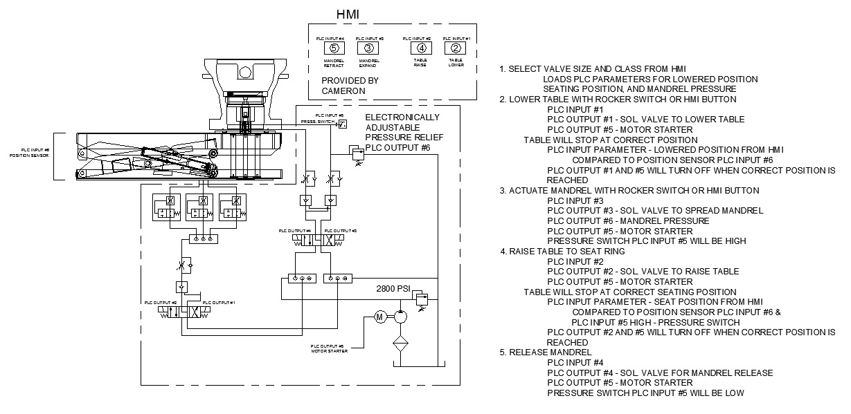
Controls

